Slide 2
Exodus 20:16
New Living Translation
You must not testify falsely against your neighbor.

Slide 3
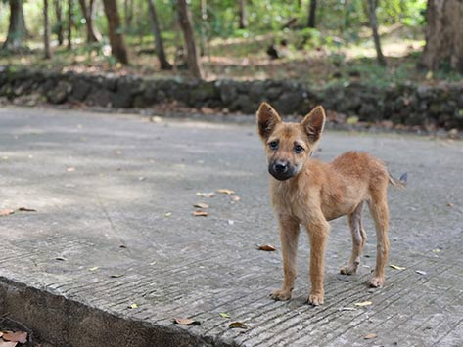

Slide 4
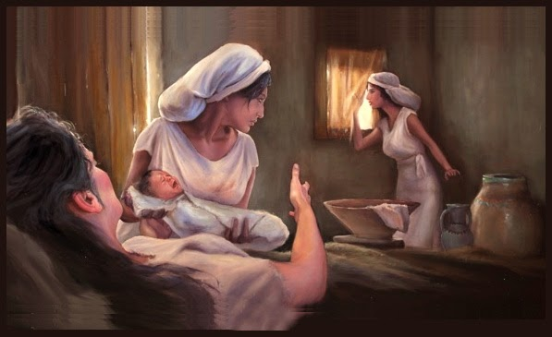
Shiphrah & Puah
(Artist Unknown)

Slide 5
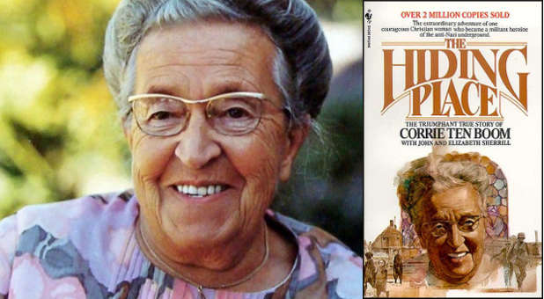

Slide 6
Ephesians 4:29
New Living Translation
Don’t use foul or abusive language. Let everything you say be good and helpful, so that your words will be an encouragement to those who hear them.

Slide 7
Lies
1. Lies hurt us

Slide 8
Luke 12:2
New Living Translation
² The time is coming when everything that is covered up will be revealed, and all that is secret will be made known to all. ³ Whatever you have said in the dark will be heard in the light, and what you have whispered behind closed doors will be shouted from the housetops for all to hear!

Slide 9
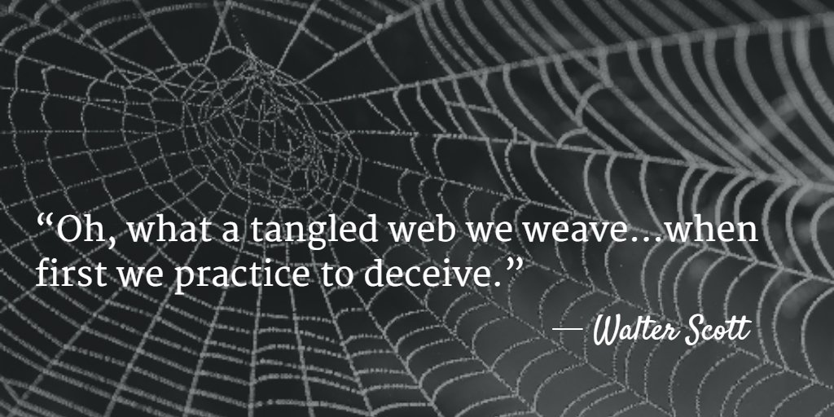

Slide 10
Lies
1. Lies hurt us
2. Lies hurt our relationships with others

Slide 11
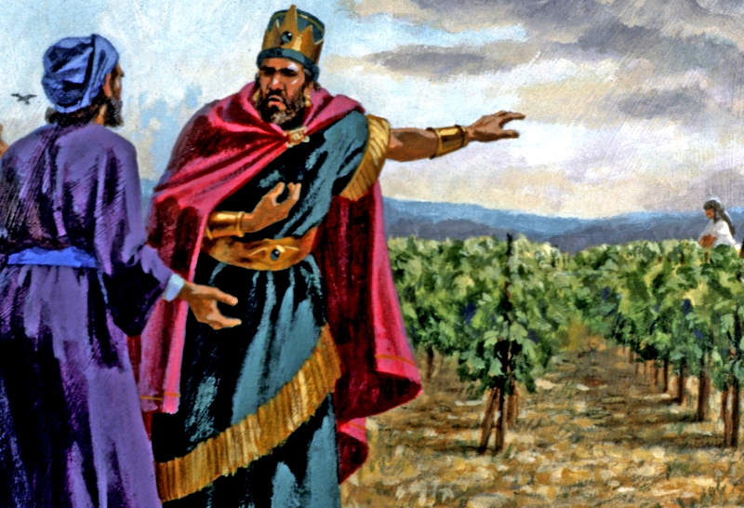
Naboth’s Vineyard
1 Kings 21

Slide 12
1 Kings 21:13
New Living Translation
Then the two scoundrels came and sat down across from him. And they accused Naboth before all the people, saying, “He cursed God and the king.” So he was dragged outside the town and stoned to death.

Slide 13
Ephesians 4:25
New Living Translation
So stop telling lies. Let us tell our neighbors the truth, for we are all parts of the same body.

Slide 14
Lies
1. Lies hurt us
2. Lies hurt our relationships with others
3. What we do reflects on God

Slide 15
Numbers 23:19
New Living Translation
God is not a man, so he does not lie. He is not human, so he does not change his mind. Has he ever spoken and failed to act? Has he ever promised and not carried it through?

Slide 16
Heidelberg Catachism
1. God’s will is that I never give false testimony against anyone.
2. I twist no one’s words.
3. I do not gossip or slander.
4. I do not join in condemning anyone without a hearing or without a just cause.
5. Rather, in court and everywhere else, I should avoid lying and deceit of every kind; these are devices the devil himself uses, and they would call down on me God’s intense anger.
6. I should love the truth.
7. I should speak the truth candidly.
8. I should openly acknowledge the truth.
9. I should do what I can to guard and advance my neighbor’s good name.

